Slide 1

Swipe and Unit Data Analysis Burcu Atik
File created on: 2021-06-19 12:40:42 PM

Slide 2
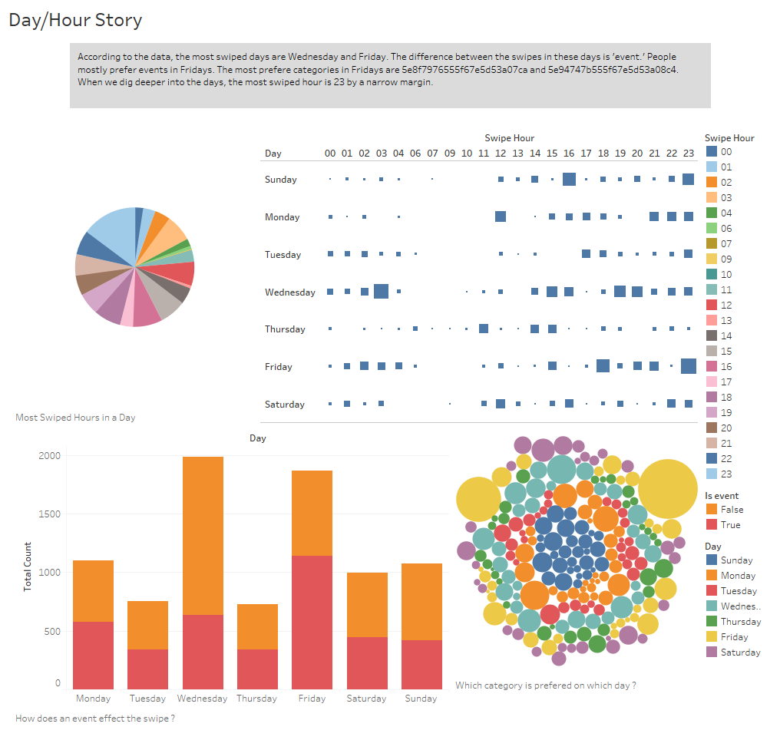

Slide 3
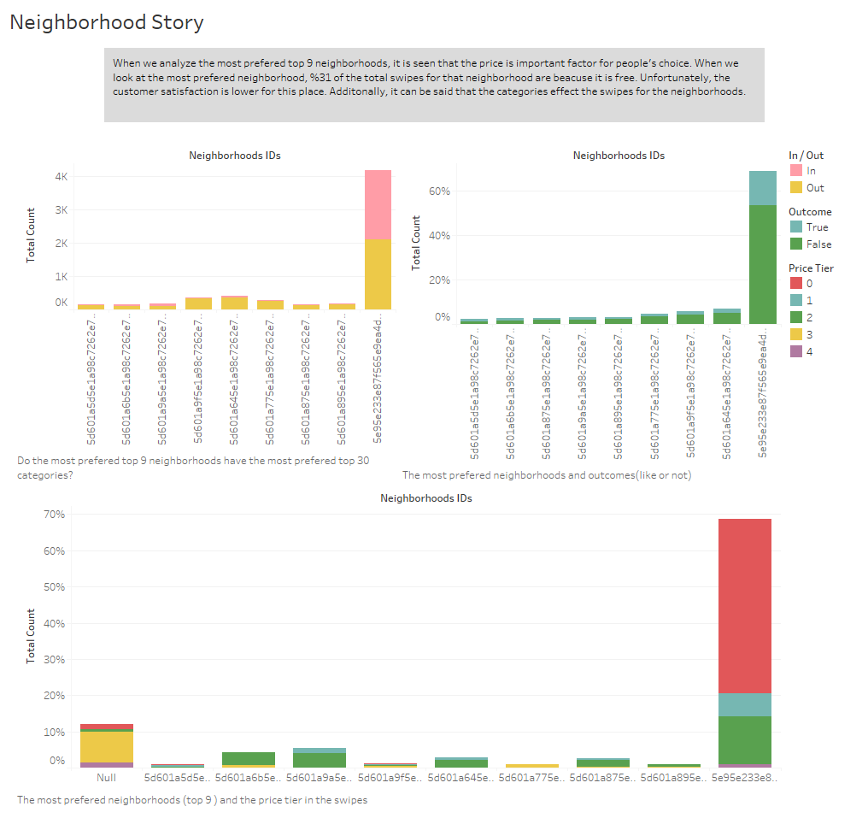

Slide 4

Thank you …

